Slide 1
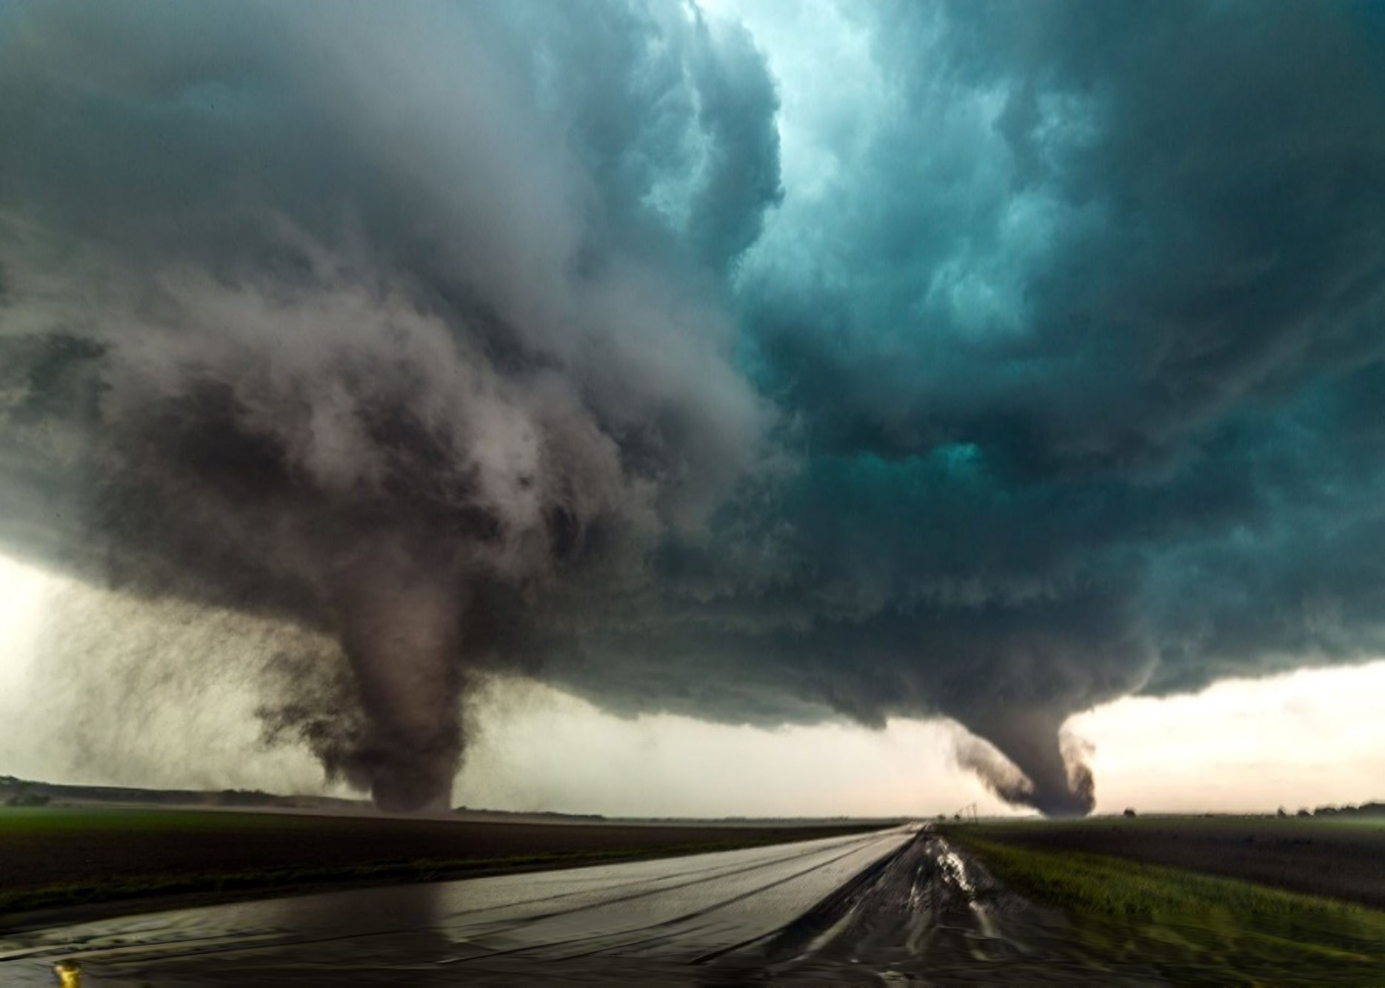

Disaster Risk Reduction and
Climate Change Adaptation Symposium
(Wind Hazard)
Photo courtesy of Scott Peake
Center for Hazard Mitigation and
Community Resilience (HMCR)
Missouri University of Science and Technology
April 28, 2022
Notes:
Nicole, consider to use blue background and white words for the overall website.

Slide 2
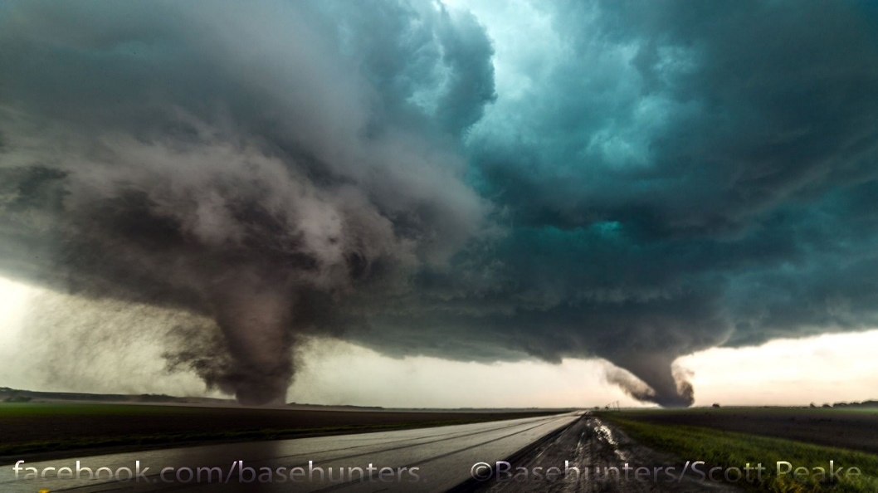
Photo courtesy of Scott Peake
Notes:
Picture 0

Slide 3

Notes:
Picture 3

Slide 4
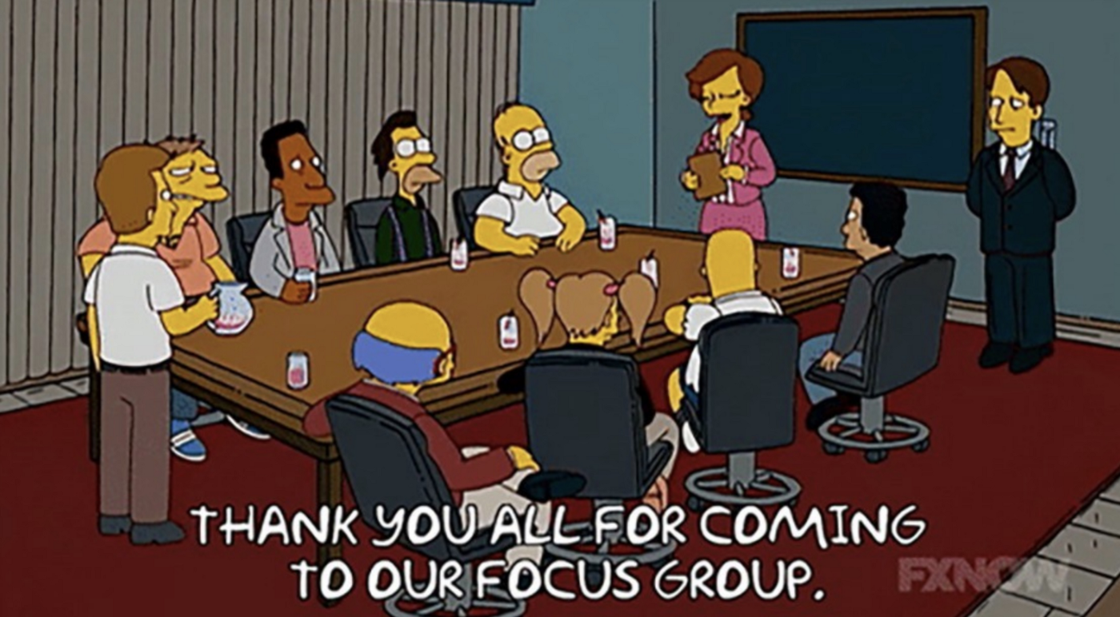
Notes:
Picture 4

Slide 5
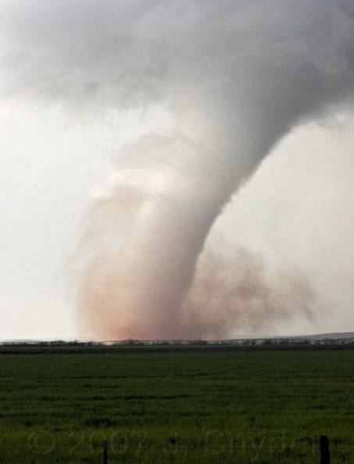
courtesy of Jeffrey Snyder
Notes:
Picture 5

